Slide 1

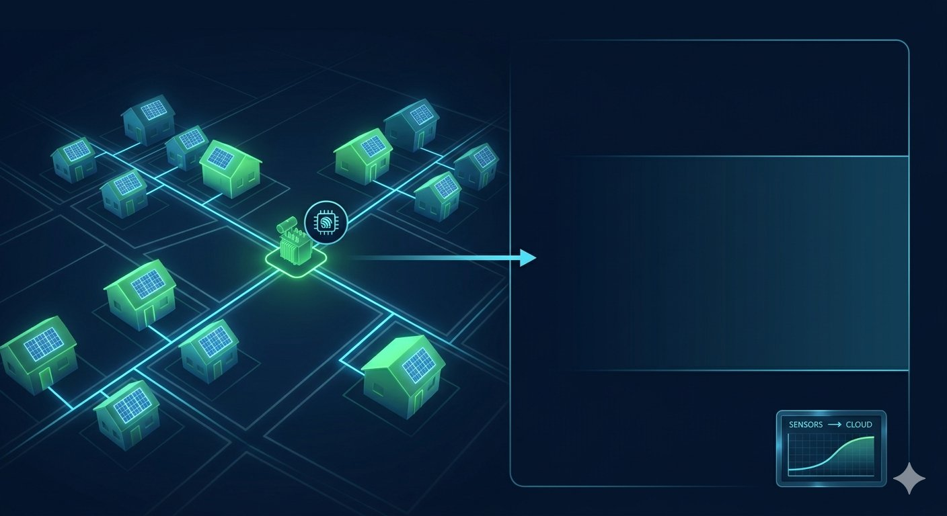
TITLE: GridTwin: AI-Powered Digital Twin for Community Energy Resilience
Team Name:Velora
College:Sona College Of Technology
Theme: Sustainable Development and renewable energy
Presented by:team
PROBLEM STATEMENT:
As communities add solar panels, EV chargers, and other distributed energy resources, local grid operators struggle to understand if the infrastructure can handle the new load. Building a physical grid upgrade just to test a scenario is prohibitively expensive.

Slide 2
PROPOSED SOLUTION:
A low-cost IoT sensor kit on a community transformer feeds real-time data to a local digital twin. It works in manual mode (rule-based alerts) and AI mode (forecasts load, simulates solar/EV scenarios, suggests optimal solutions). A dashboard visualizes everything, enabling communities to test grid upgrades virtually without physical infrastructure.
HOW IT ADDRESS THE PROBLEM:
✅ Real-time sensors keep the digital twin accurate
✅ Manual mode gives instant overload alerts; AI mode predicts and prevents issues
✅ Enables safe solar/EV integration without outages or costly upgrades
✅ Works offline, making clean energy accessible in remote area
UNIQUE VALUE PROPOSITIONS:
Infrastructure Cost Reduction: Slashes hardware deployment costs from ₹4,0,000+ down to a budget-friendl.
Non-Invasive "Zero-Friction" Setup: Clamps onto the low-voltage consumer side with no dangerous line-cutting or complex regulatory approvals.
Interactive "What-If" Grid Sandbox: Converts abstract power-flow math into a gamified dashboard with simple sliders for non-technical community leaders.
Hybrid Cloud Compute Efficiency: Keeps on-site hardware lightweight by offloading heavy grid physics to an optimized, open-source Python cloud engine.
Bottom-Up Resilience Optimization: Empowers local citizens to independently validate and scale their own renewable assets before spending heavy capital.

Slide 3
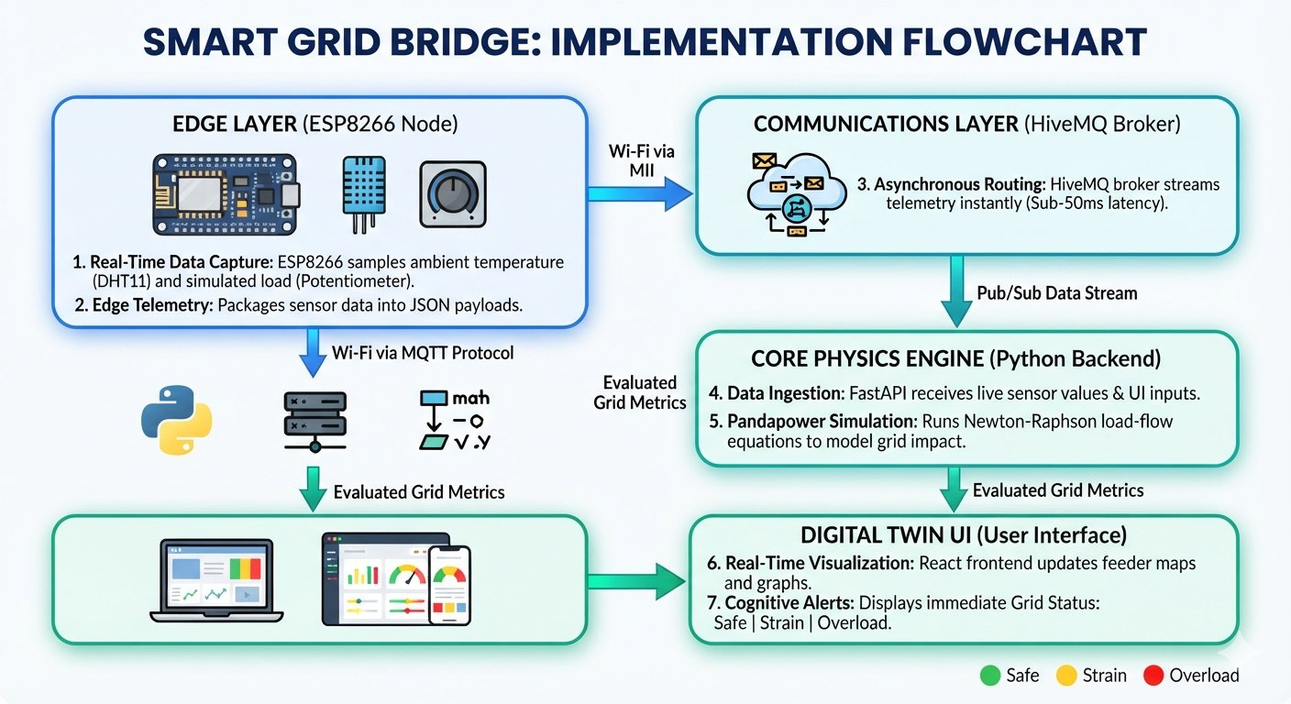
TECHNICAL APPROCH

Slide 4
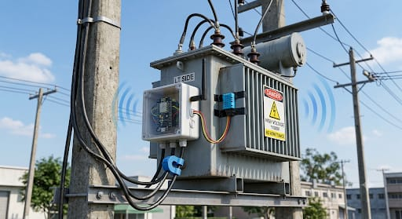
Software:
Python: Runs the backend and grid math.
C++ (Arduino): Programs the ESP8266 chip.
JavaScript: Builds the web dashboard.
Pandapower: Python library for grid physics.
FastAPI: Handles fast backend data communication.
React.js: Creates the user dashboard UI.
Hardware:
ESP8266 NodeMCU: Main Wi-Fi microchip for data processing.
DHT11 Sensor: Tracks heat to simulate transformer stress.
Cloud & Infrastructure
HiveMQ / EMQX: Routes live sensor data instantly.
Vercel / Render: Hosts the app online for free.

Slide 5
INNOVATION
💡 THE INNOVATION | ✨ WHY IT’S UNIQUE
🎛️ The Interactive "What-If" Sandbox Transforms abstract engineering into a gamified dashboard. Users use physical dials or software sliders to predict instant grid outcomes. | 🏢 Enterprise Tech for Communities Brings multi-million-dollar utility predictive modeling (like Siemens or GE) straight to local neighborhoods and solar co-ops.
🖲️ ₹700 Edge Hardware Operates using an ultra-low-cost, energy-efficient ESP8266 node equipped with digital sensors. | 🧲 Non-Invasive Deployment Measures parameters strictly from the low-voltage consumer side. It requires zero dangerous modifications to utility lines.
☁️ Hybrid Edge-Cloud Core The hardware gathers data swiftly, while heavy mathematical grid physics are offloaded to an optimized Python cloud engine. | 🪵 Bottom-Up Grid Optimization Flips traditional top-down utility management. It lets citizens independently validate infrastructure before spending capital.
"Test tomorrow's grid today without upgrading a single wire."

Slide 6
Example:
Parameter | Value | Status
Temperature | 42.5 °C | 🟢 Normal
Load | 75 kVA | 🟢 Safe
Solar | 20 kW | 🟢 Generating
EV Charging | 5 cars | 🟢 Normal
Transformer | 75% loaded | 🟢 Safe

Slide 7
SmartGrid Bridge: Impact, Benefits & Sustainability
Target Audience Impact:
Local Neighborhoods & Co-ops: Eliminates blackout fears; gives non-technical leaders a visual sandbox to maximize local solar distribution.
EV Owners & Fleet Operators: Identifies exactly how many vehicles can charge at peak hours without tripping the local transformer.
Utility Operators (DISCOMs): Serves as an affordable early-warning system to prevent unexpected grid failure and asset breakdowns.
Solution Benefits:
Data Democratization: Shifts actionable energy insights from closed utility giants down to everyday citizens.
Zero-Friction Deployment: Installs instantly via non-invasive, external sensors with no line-cutting or complex regulatory approvals.
Asset Life Extension: Tracks real-time thermal spikes to prevent permanent equipment damage.
Economic & Environmental Impact:
95%+ Cost Reduction: Slashes asset monitoring infrastructure costs from ₹4,00,000+ down to under ₹6,500 per node.
CapEx Optimization: Unlocks hidden grid capacity, saving communities millions in premature, forced physical upgrades.
Accelerated Decarbonization: Speeds up local solar and EV infrastructure deployment while saving raw copper and steel mining waste.

Slide 8
Feasibility :
Proven Math Engine: Uses mature, open-source Python libraries (pandapower/OpenDSS) to solve complex grid physics automatically.
Plug-and-Play Hardware: Uses the cheap, widely documented ESP8266 chip with simple breadboard wiring.
Lightweight Load: Heavy computing runs in the cloud; the hardware only handles simple data streaming.
Zero-Risk Fallback: Can run entirely as a software simulation if physical hardware fails on the judging table.
Viability :
Massive Cost Cut: Slashes asset monitoring costs from ₹4,00,000+ (industrial utility tech) to under ₹6,500 per node.
High Market Demand: Directly solves the real-world bottleneck of grids overloading due to rapid EV and solar adoption.
Zero Regulatory Friction: Non-invasive, low-voltage external sensors mean no dangerous utility line-cutting or legal approvals needed.
Global Scalability: Open-source codebase can be adapted quickly to any neighborhood or country's grid standards via software.

Slide 9
Digital Twin & Transformer Modeling:
Low-Voltage Feasibility: Research from IEEE Trans on Power Delivery [1] proves that low-voltage side measurements can accurately calculate real-time internal transformer thermal stress without touching dangerous high-voltage lines.
Community-Scale Twins: A case study in the IEEE Library [1] shows how a localized digital twin can successfully balance variable solar power against real-time household demand in a small island community.
Edge-to-Cloud Precision: Academic validation via arXiv [1] demonstrates that thin IoT edge layers can capture structural data points accurately enough to predict distribution network asset failures.
Grid Physics Frameworks:
Pandapower Validation: Studies from Cornell University [1] benchmark Pandapower as an industry-standard, high-fidelity Python framework for processing dense neighborhood EV charging simulation models.
Open-Source Co-Simulation: Research from ResearchGate [1] proves that pairing open-source tools with digital twin interfaces allows operators to accurately map out grid safety margins without expensive proprietary software.

Slide 10
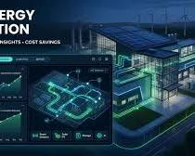
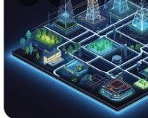

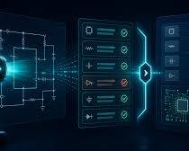
THANK YOU

